Slide 1

Prima Mart Scanner
App Walkthrough — Pages, Buttons & Real-Backend Workflow
100% REAL DATA — NO MOCKS
Captured against the live OCR + AI classification backend, with a real account and zero staged data

Slide 2
OVERVIEW
What We'll Walk Through
01
Architecture at a Glance
How the Flutter app, gateway, OCR pipeline & AI classifier fit together
02
Auth & Navigation
Login, permissions, the drawer, and the DO/Product mode switch
03
DO Scan End-to-End
Photo → blur check → real OCR → review → confirm → printable receipt
04
Product Scan End-to-End
Photo → AI SKU classification → auto expiry read → confirm
05
History, Logout & Guardrails
Confirmed records, the unsynced-document warning, real failure states
06
Key Algorithms
Laplacian blur score, upload/poll/retry logic, DINOv2 similarity search
Prima Mart Scanner — App Walkthrough
2

Slide 3
SYSTEM DESIGN
Architecture at a Glance
HTTPS + JWT
REST /v1/*
SQL
Flutter App
(this UI)
Next.js API
Gateway
OCR Pipeline
(PaddleOCR + vLLM)
DINOv2 Classifier
PostgreSQL
(accounts, documents,
SKU master)
Two independent capture modes, one shared pipeline:
▸ DO Scan: photo of a paper Delivery Order → PaddleOCR-VL-1.6 on vLLM reads header + item table → matched against sku_master.
▸ Product Scan: photo of a package → DINOv2 vision-transformer similarity search (YOLO classifier fallback) identifies the SKU, PaddleOCR reads the printed expiry date.
▸ Every write is JWT-authenticated (Authorization: Bearer <token>) and geotagged with the device's GPS at capture time.
Prima Mart Scanner — App Walkthrough
3

Slide 4

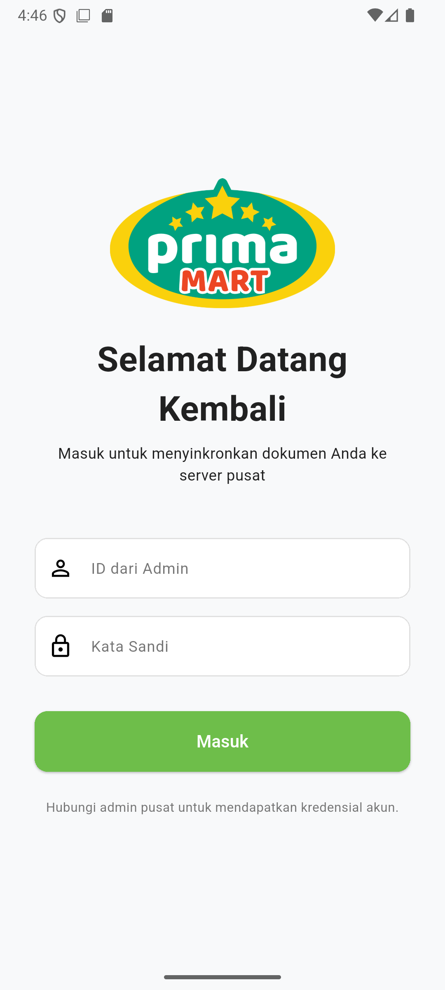
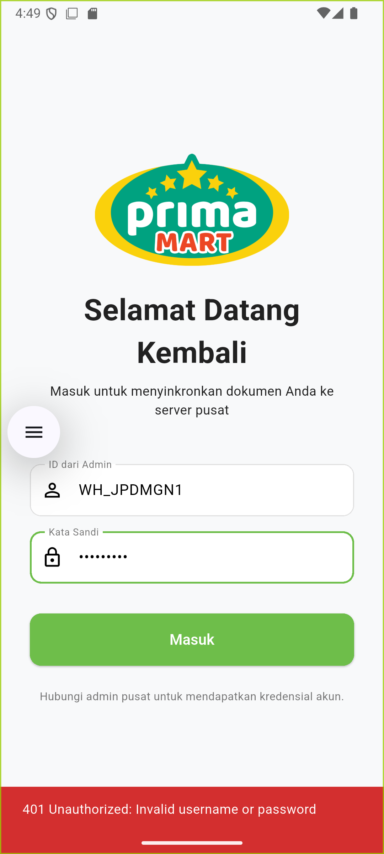
1
SECTION 1 • AUTH
Splash & Login
▸ Masuk: calls POST /api/v1/auth/login.
▸ Real bcrypt check — the 401 banner shown is the backend's own rejection message, not client-side.
▸ No self-serve signup — credentials come from a central admin.
1. Splash screen
2. Login form (empty)
3. Wrong password → real 401
Prima Mart Scanner — App Walkthrough
4

Slide 5
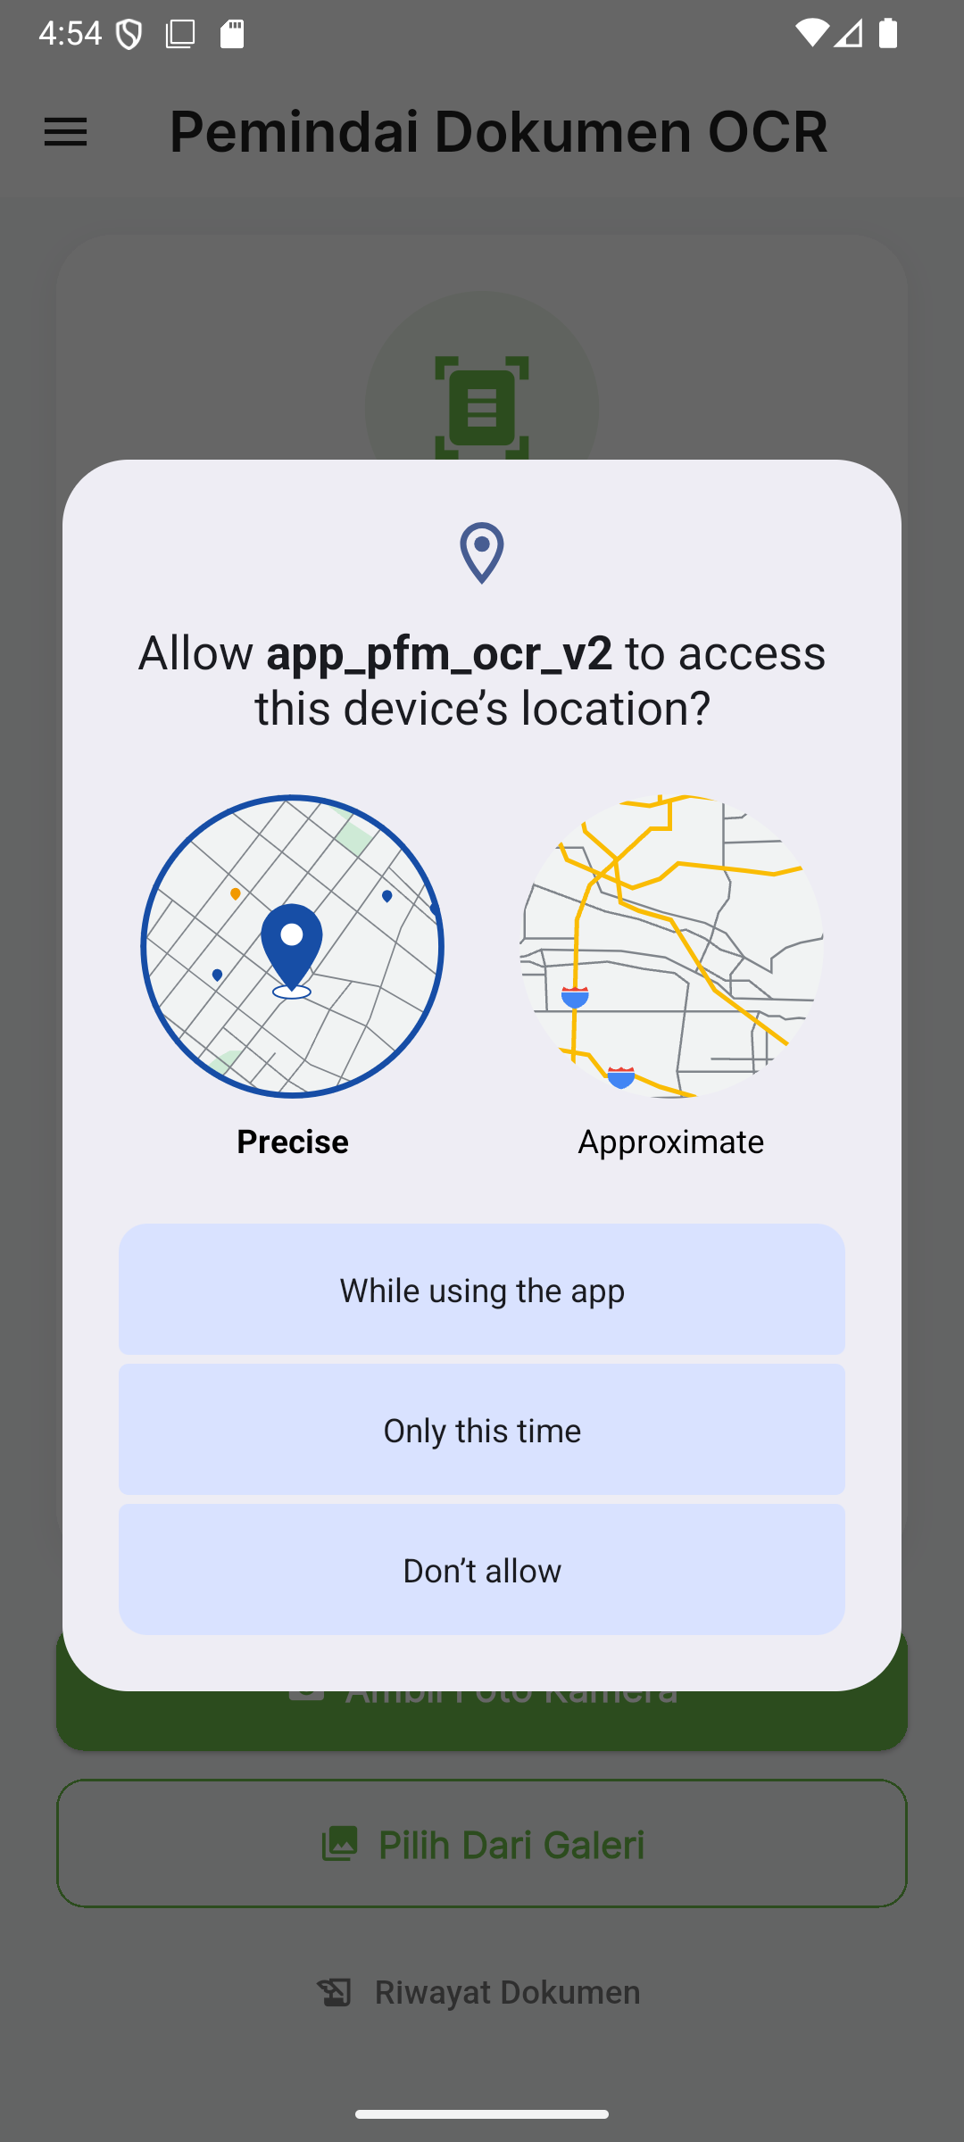
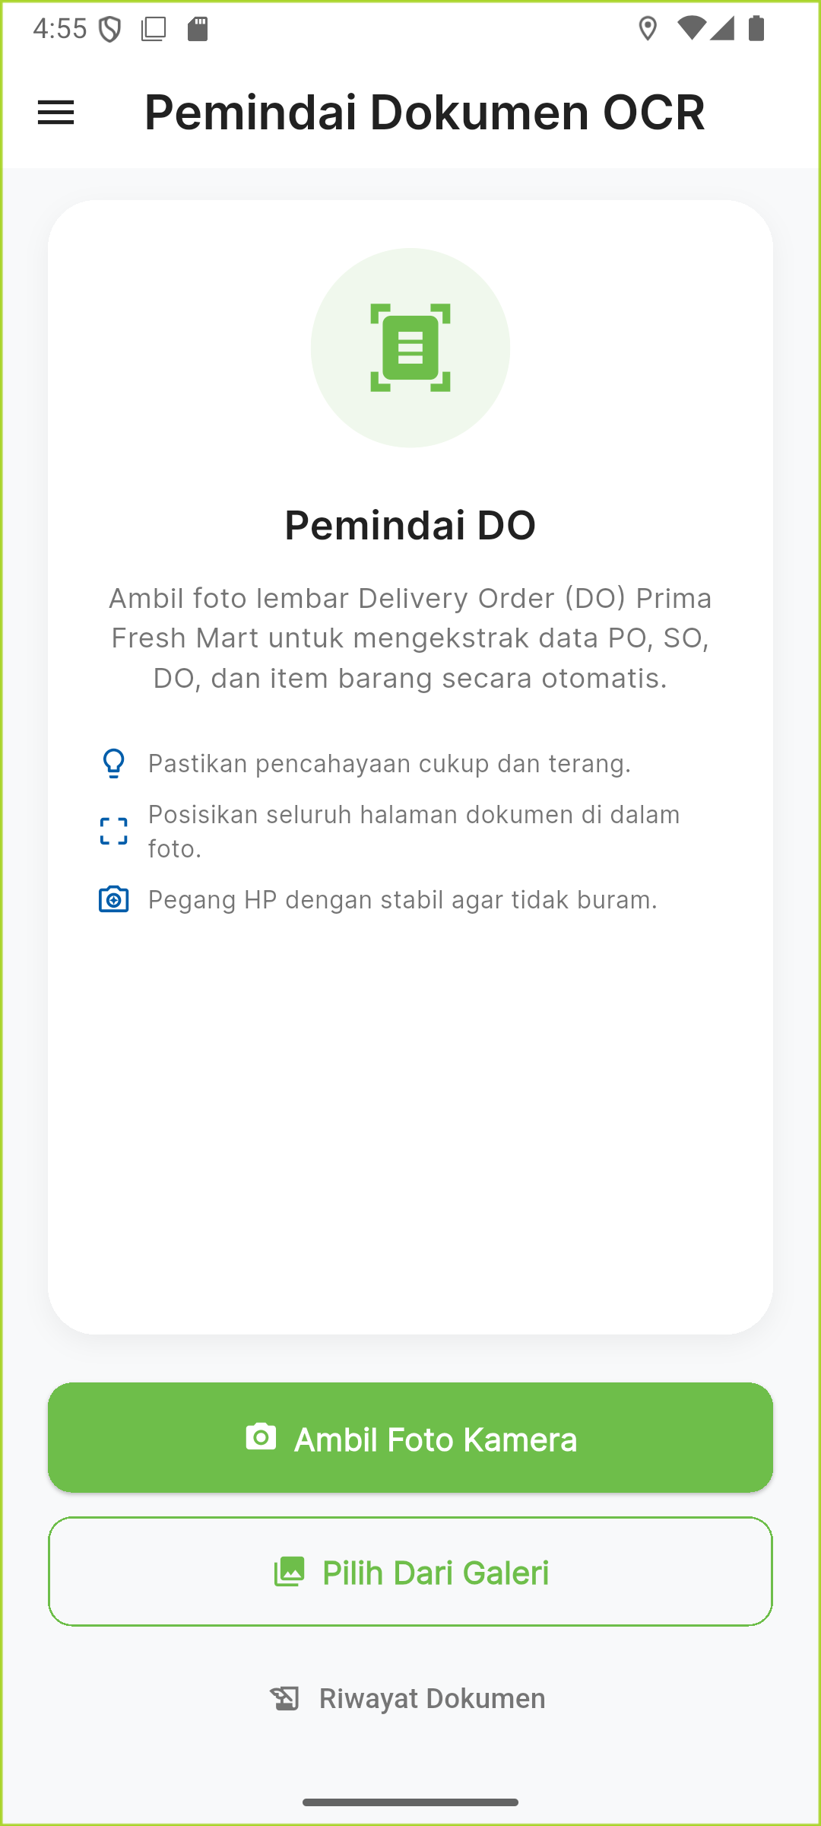
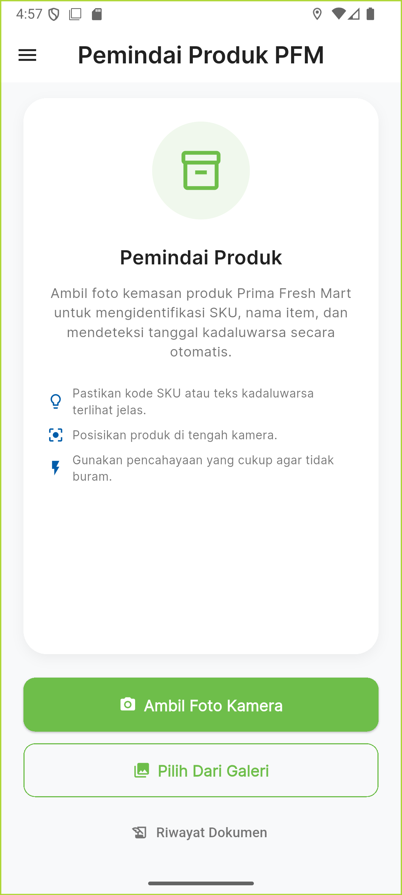
1
SECTION 1 • AUTH
Location Permission & Camera Home
▸ Why location? every uploaded document is geotagged at capture time — requested once, right after login.
▸ Ambil Foto Kamera opens the OS camera (2048×2048 @ 85% JPEG).
▸ Pilih Dari Galeri opens the OS photo picker; uses EXIF GPS if present.
▸ Riwayat Dokumen jumps straight to History.
Real Android OS prompt
DO Scan home
Product Scan home
Prima Mart Scanner — App Walkthrough
5

Slide 6
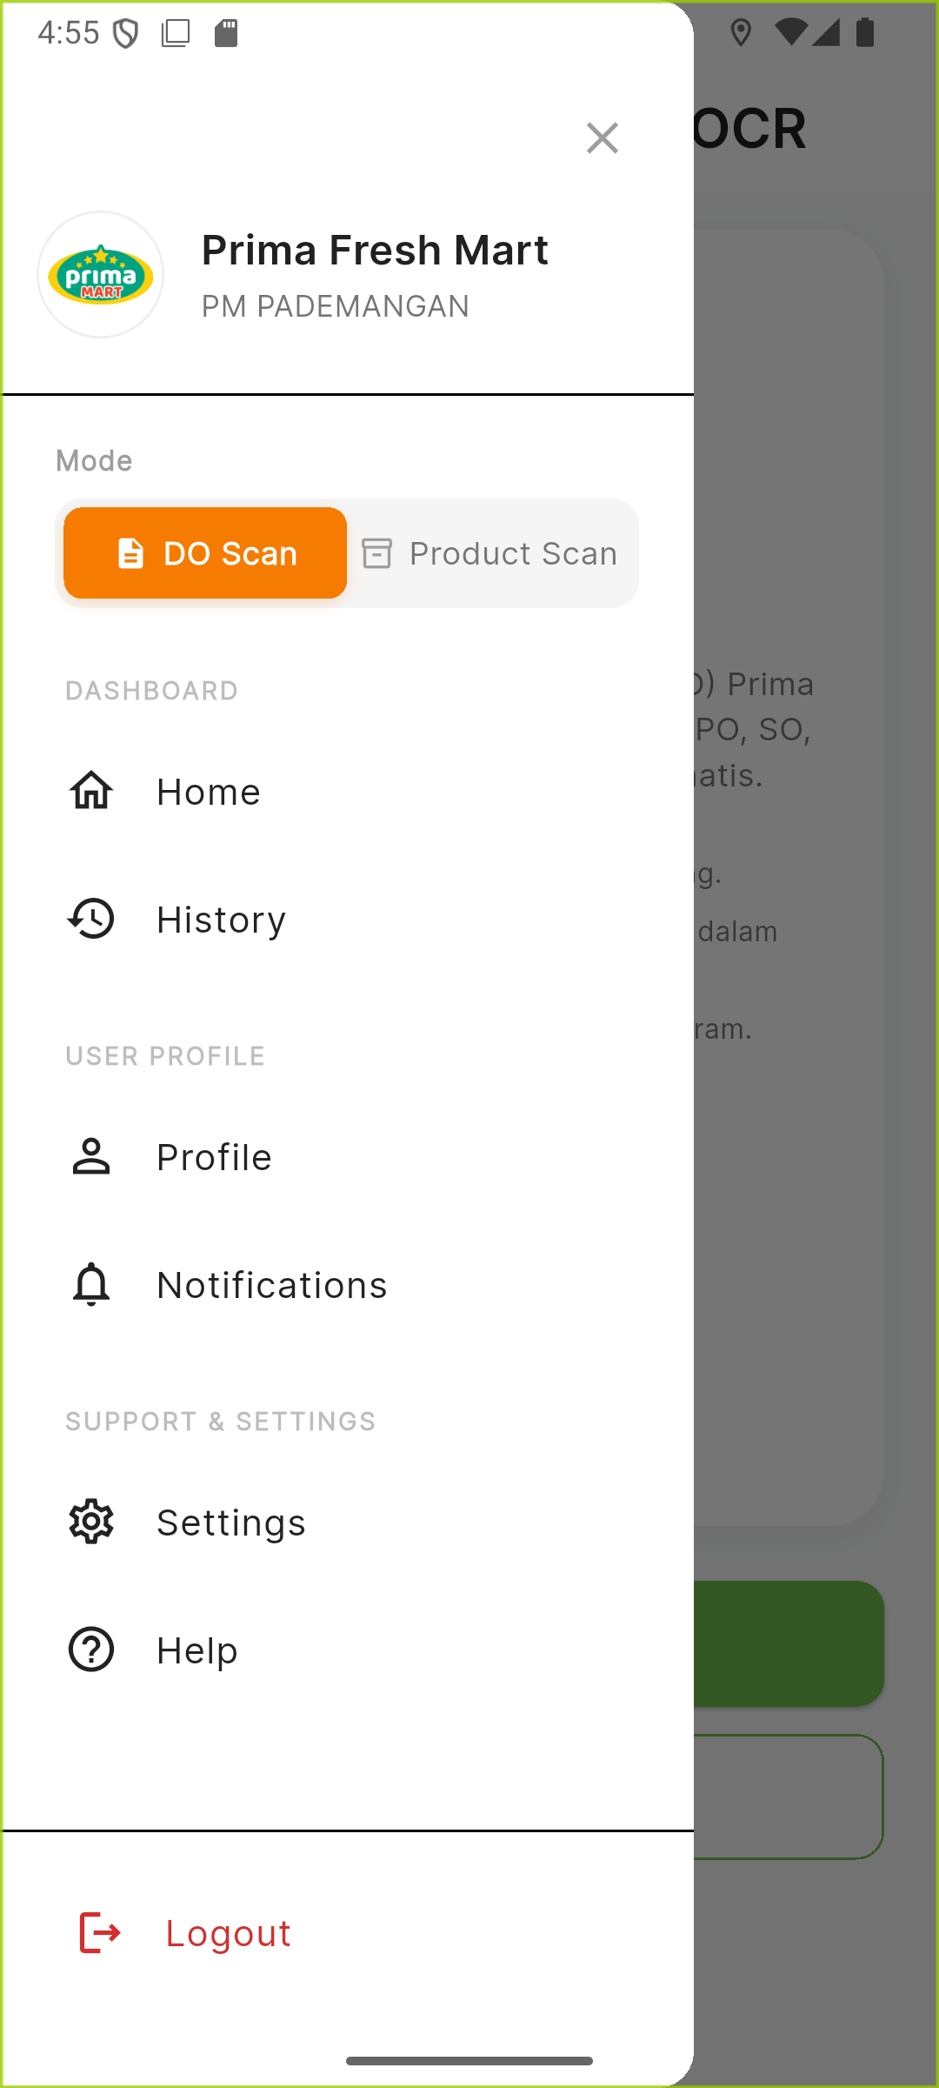
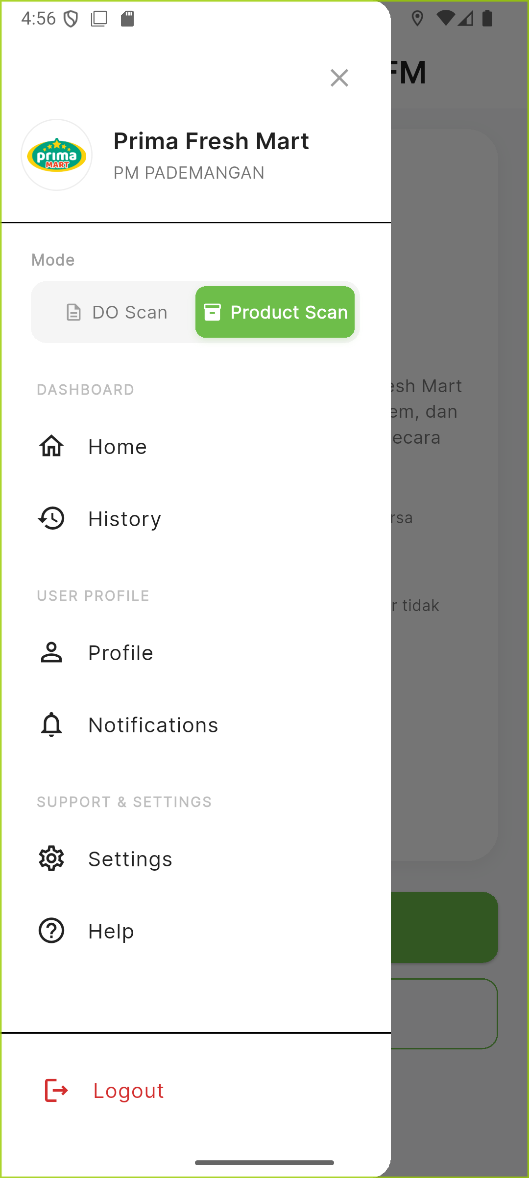
1
SECTION 1 • AUTH
Navigation Drawer & Mode Toggle
▸ Store identity “Prima Fresh Mart / PM PADEMANGAN” comes straight from the logged-in JWT profile, not hardcoded.
▸ Mode toggle global state read everywhere: camera home copy, upload's scan_mode tag, and the History tab switcher.
▸ Color convention orange = DO Scan, green = Product Scan — reused consistently across the whole app.
▸ Working items: Home, History, Mode toggle, Help, Logout.
▸ Stubbed items: Profile, Notifications, Settings — show a “coming soon” snackbar.
Drawer — DO Scan active
Toggled → Product Scan active
Prima Mart Scanner — App Walkthrough
6

Slide 7
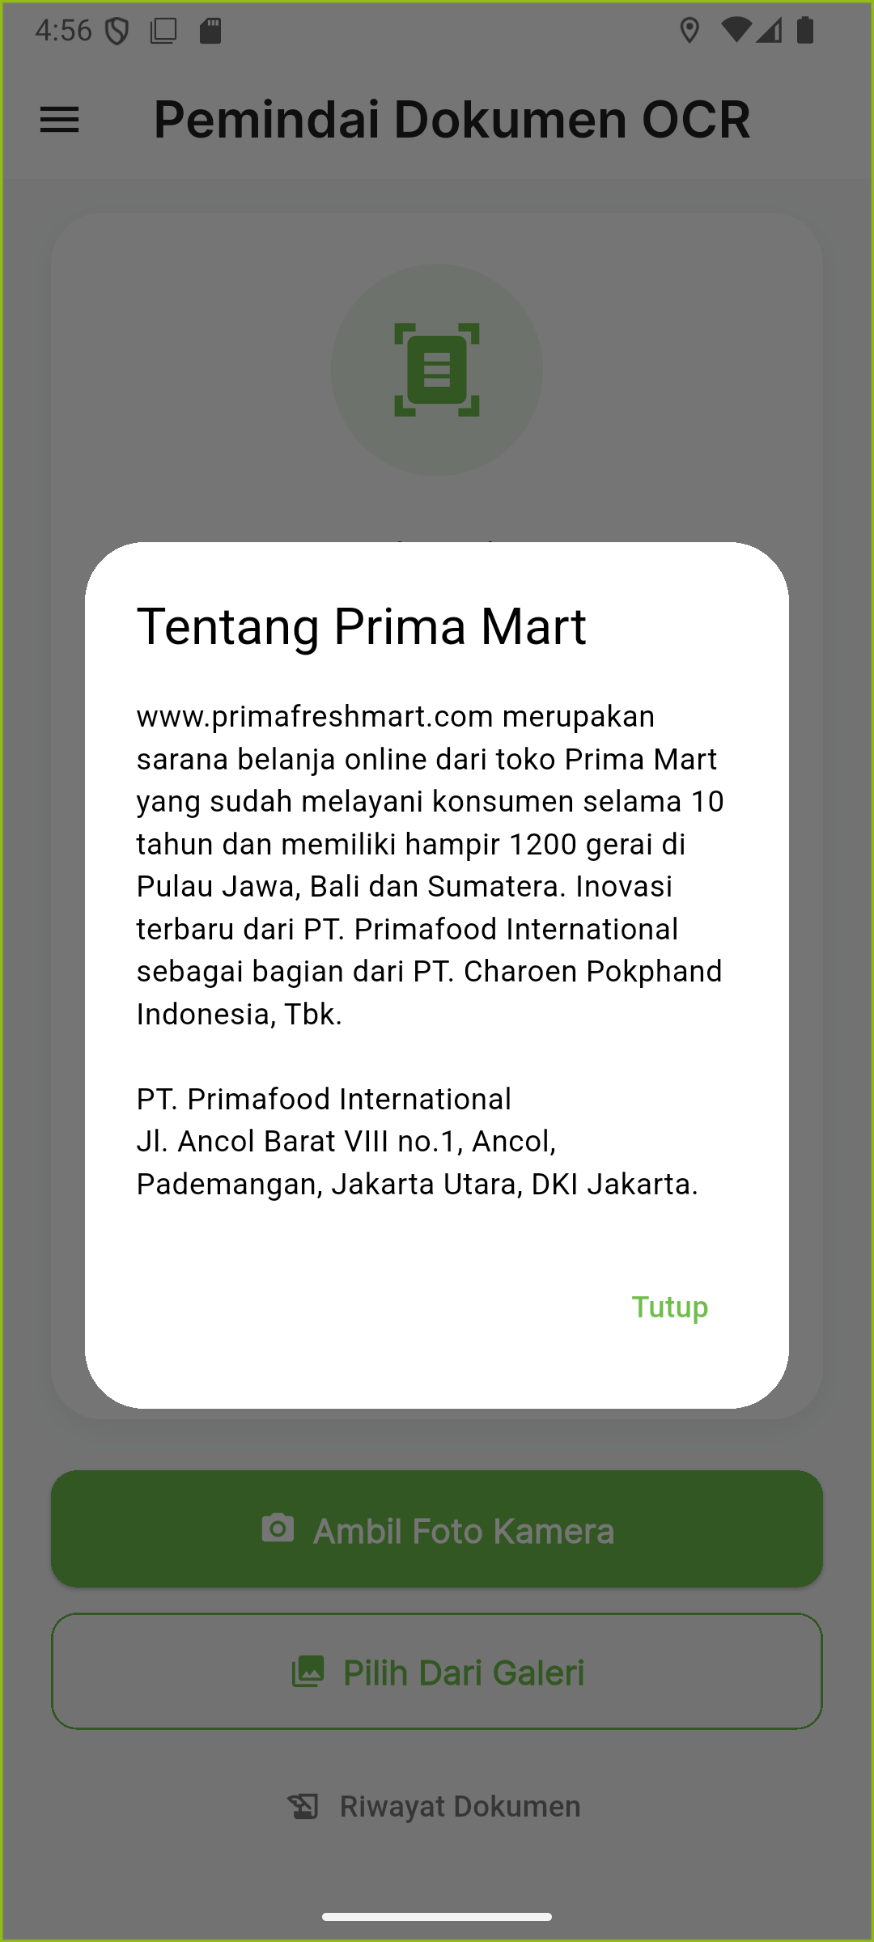
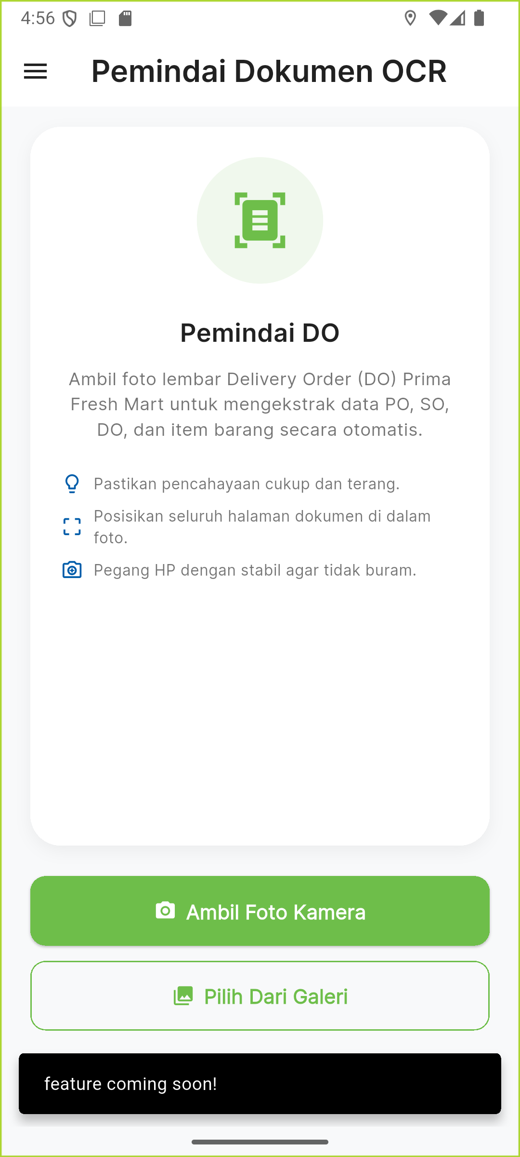
1
SECTION 1 • AUTH
Help Dialog & Not-Yet-Built Features
▸ Help opens instantly — no network call, just static company info.
▸ The other three drawer items close the drawer and surface a “feature coming soon!” snackbar — clearly scoped as future work.
Help → static “About” dialog
Profile / Notifications / Settings
Prima Mart Scanner — App Walkthrough
7

Slide 8
SECTION 2
DO Scan — End to End
Photo → Blur Check → Real OCR → Review & Edit → Confirm → Printable Receipt

Slide 9
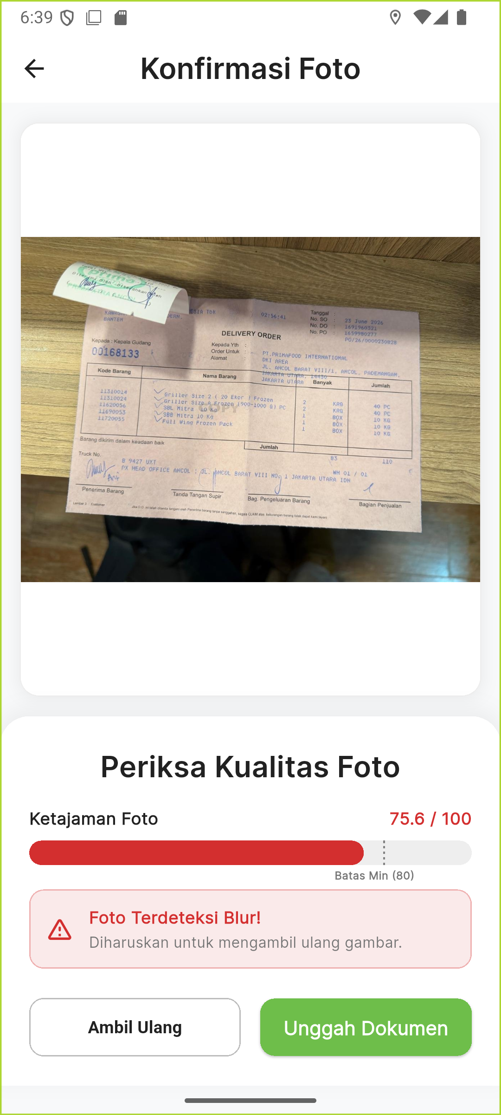
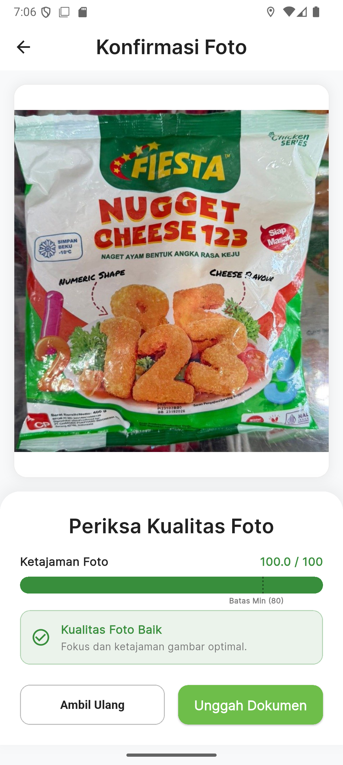
2
SECTION 2 • DO SCAN
Step 1 — On-Device Photo Quality Check
Laplacian Variance
▸ Downscale to 300px, crop center 60%
▸ Gaussian blur (denoise) → grayscale
▸ 3×3 Laplacian at every pixel:
4×center − L − R − T − B
▸ Score = variance of that Laplacian map, scaled 0–100
▸ Threshold: 80. Below it → red warning, but upload stays allowed (advisory, not blocking).
Real score: 75.6/100 → flagged blurry
Real score: 100/100 → sharp
Prima Mart Scanner — App Walkthrough
9

Slide 10
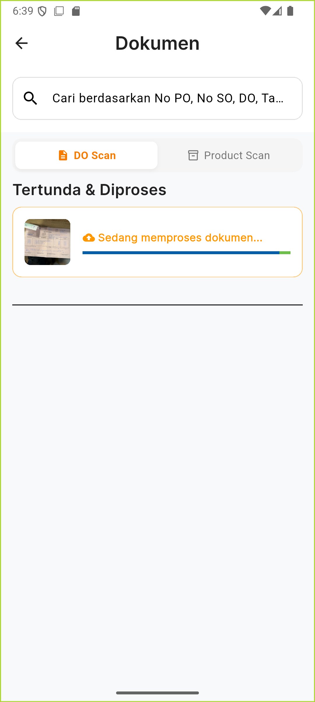
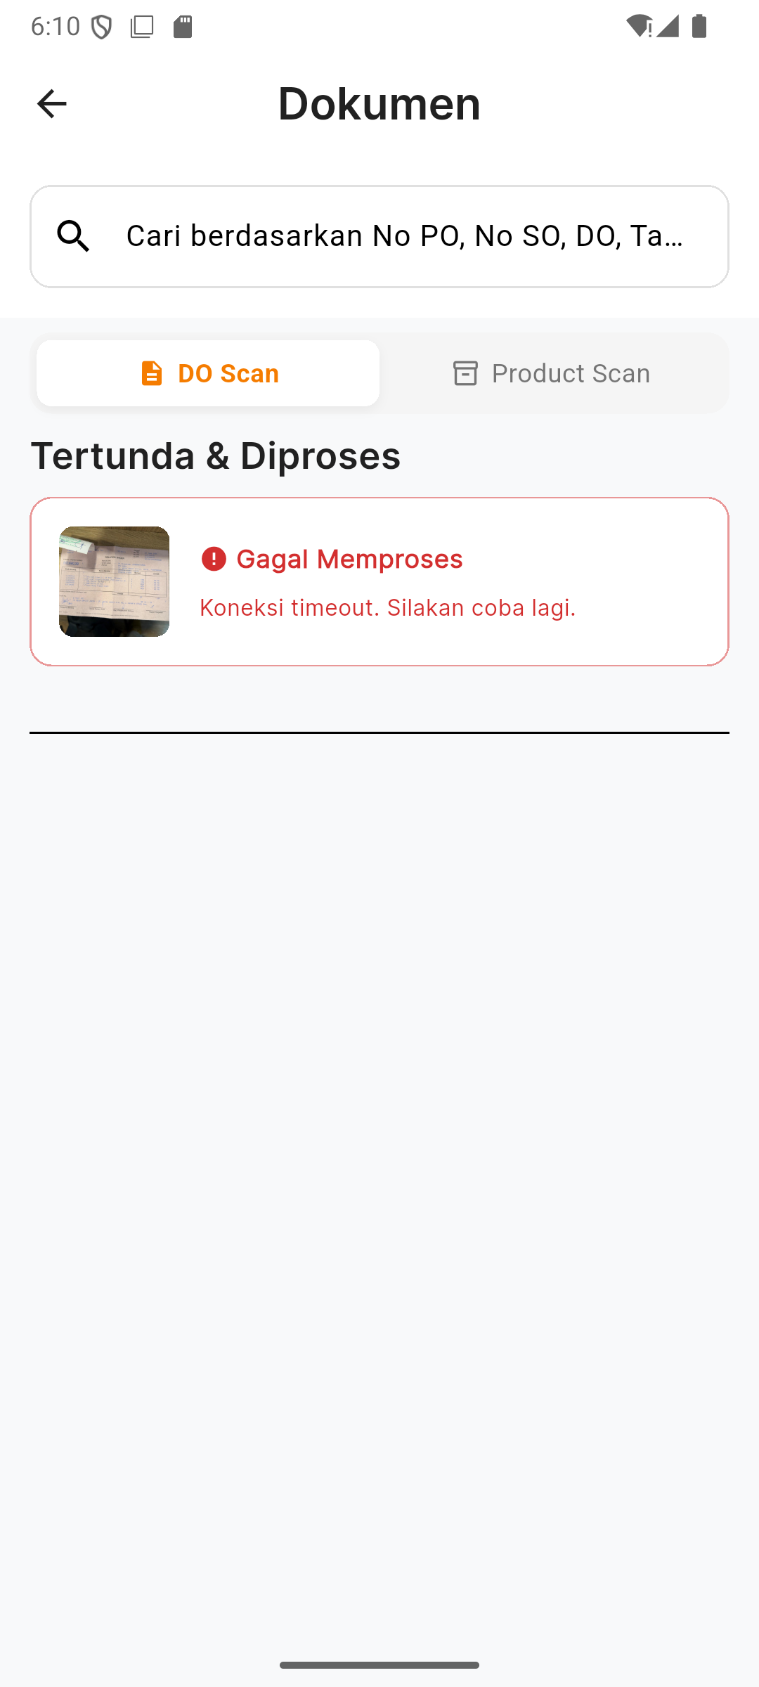
2
SECTION 2 • DO SCAN
Step 2 — Upload & Background Processing
▸ Queued instantly to a local Hive-backed store before the network call even starts — survives an app kill.
▸ POST /documents/upload (multipart: image + GPS + scan_mode), then polls GET /documents/:id every 2s, up to ~4.3 minutes.
▸ Not staged: the timeout shown here happened for real when this capture session's Wi-Fi dropped mid-flow.
▸ Auto-resume: on relaunch, any item still processing/uploading picks the poll loop back up automatically.
Uploading — lands in local queue instantly
REAL failure — host Wi-Fi dropped live
Prima Mart Scanner — App Walkthrough
10

Slide 11
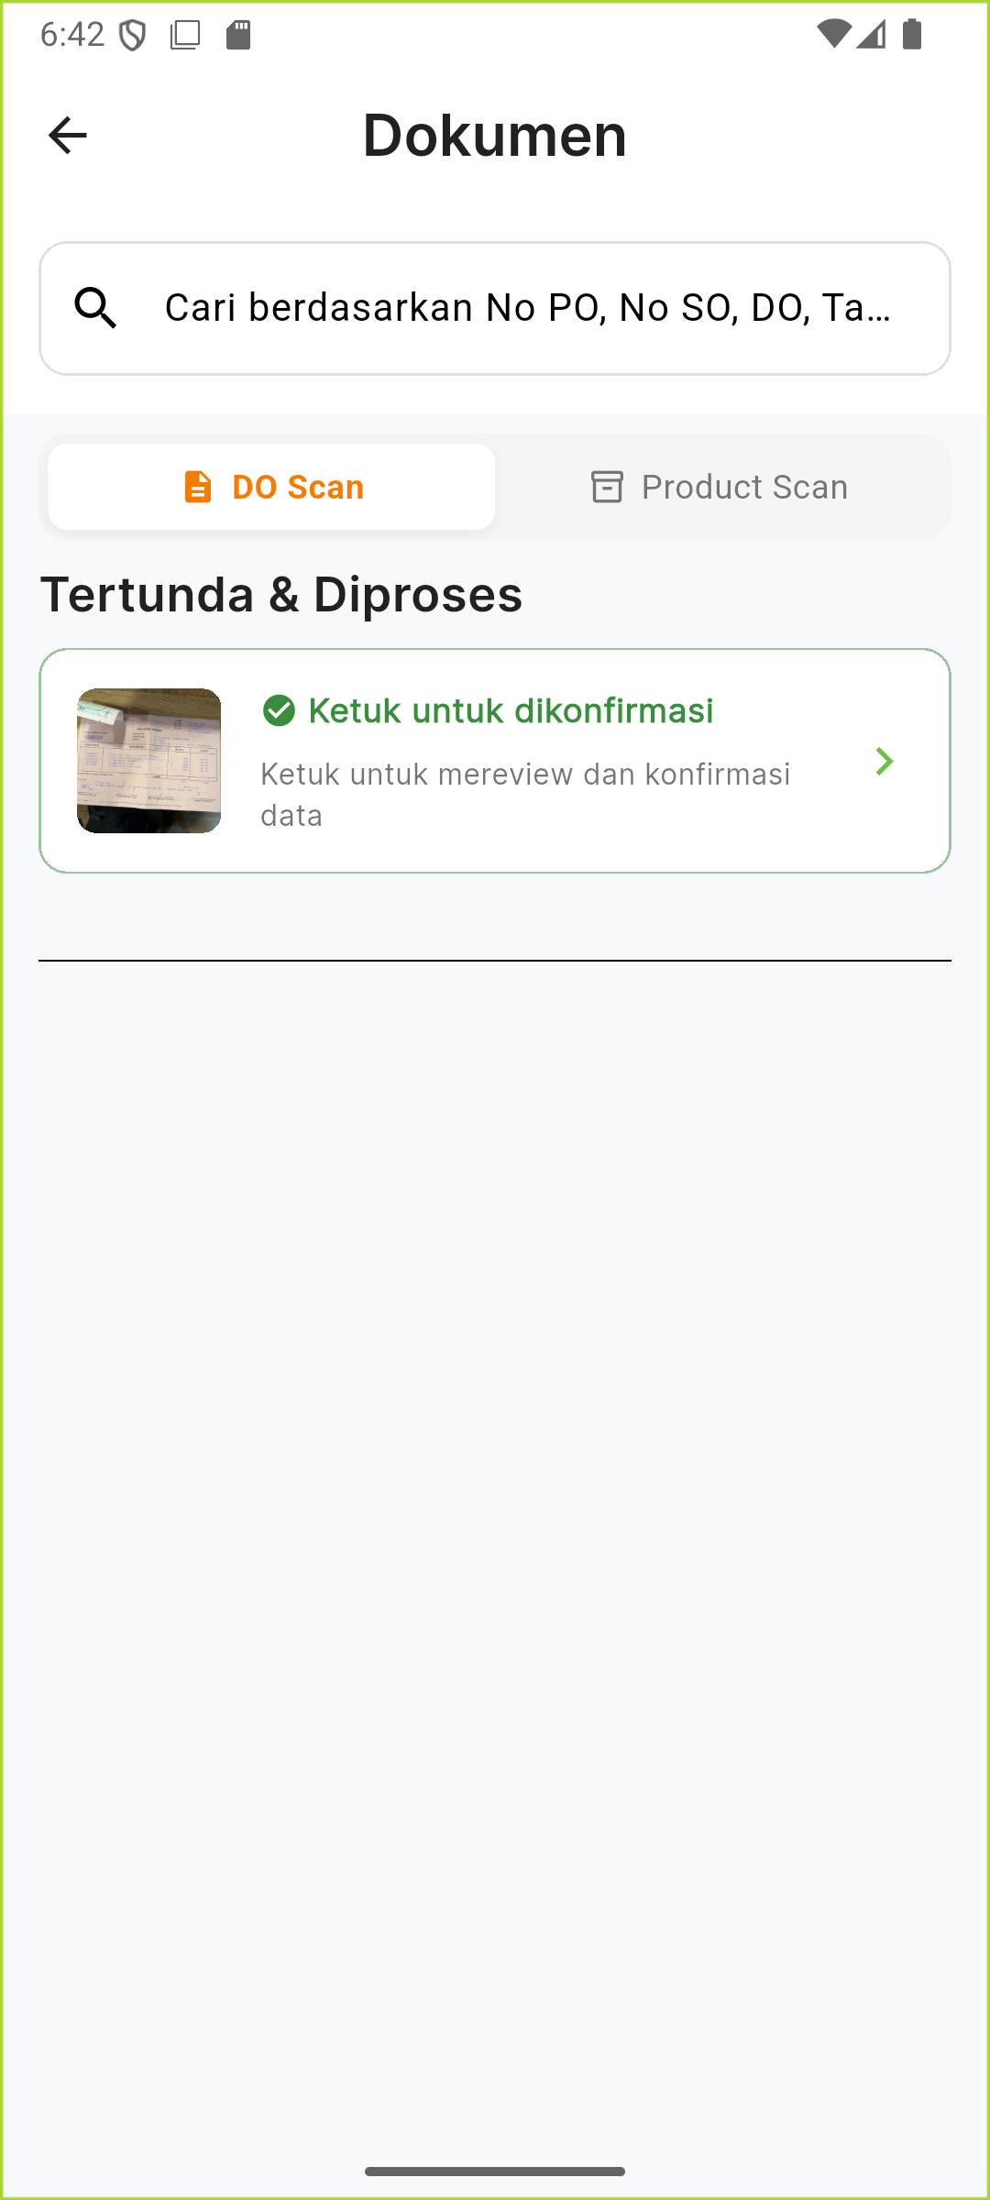
2
SECTION 2 • DO SCAN
Step 3 — Ready to Review
After the network recovered, the same document finished a real OCR pass — “Ketuk untuk dikonfirmasi” (tap to confirm) with a green check.
This is the exact same pending item from the previous slide — same document, recovered automatically once connectivity returned.
Real vLLM/PaddleOCR pass finished
Prima Mart Scanner — App Walkthrough
11

Slide 12
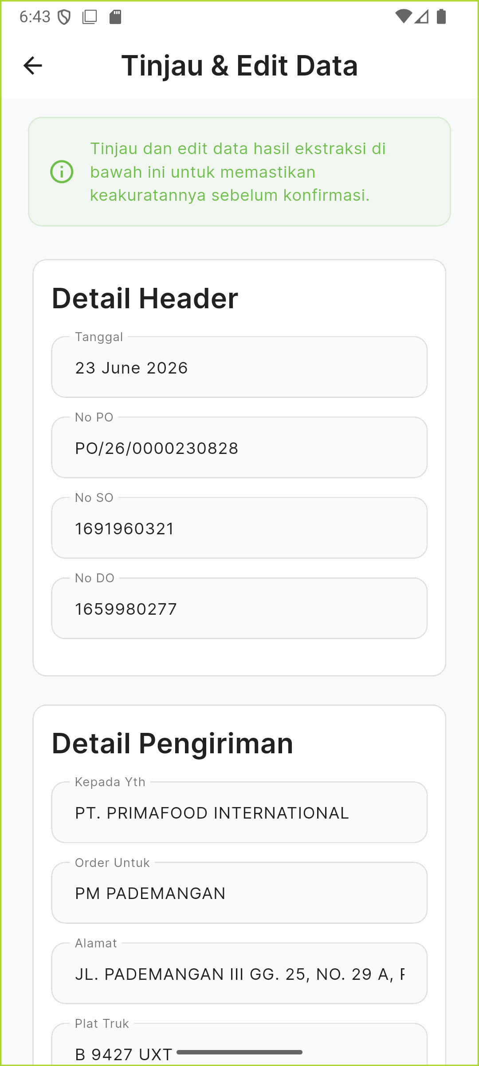
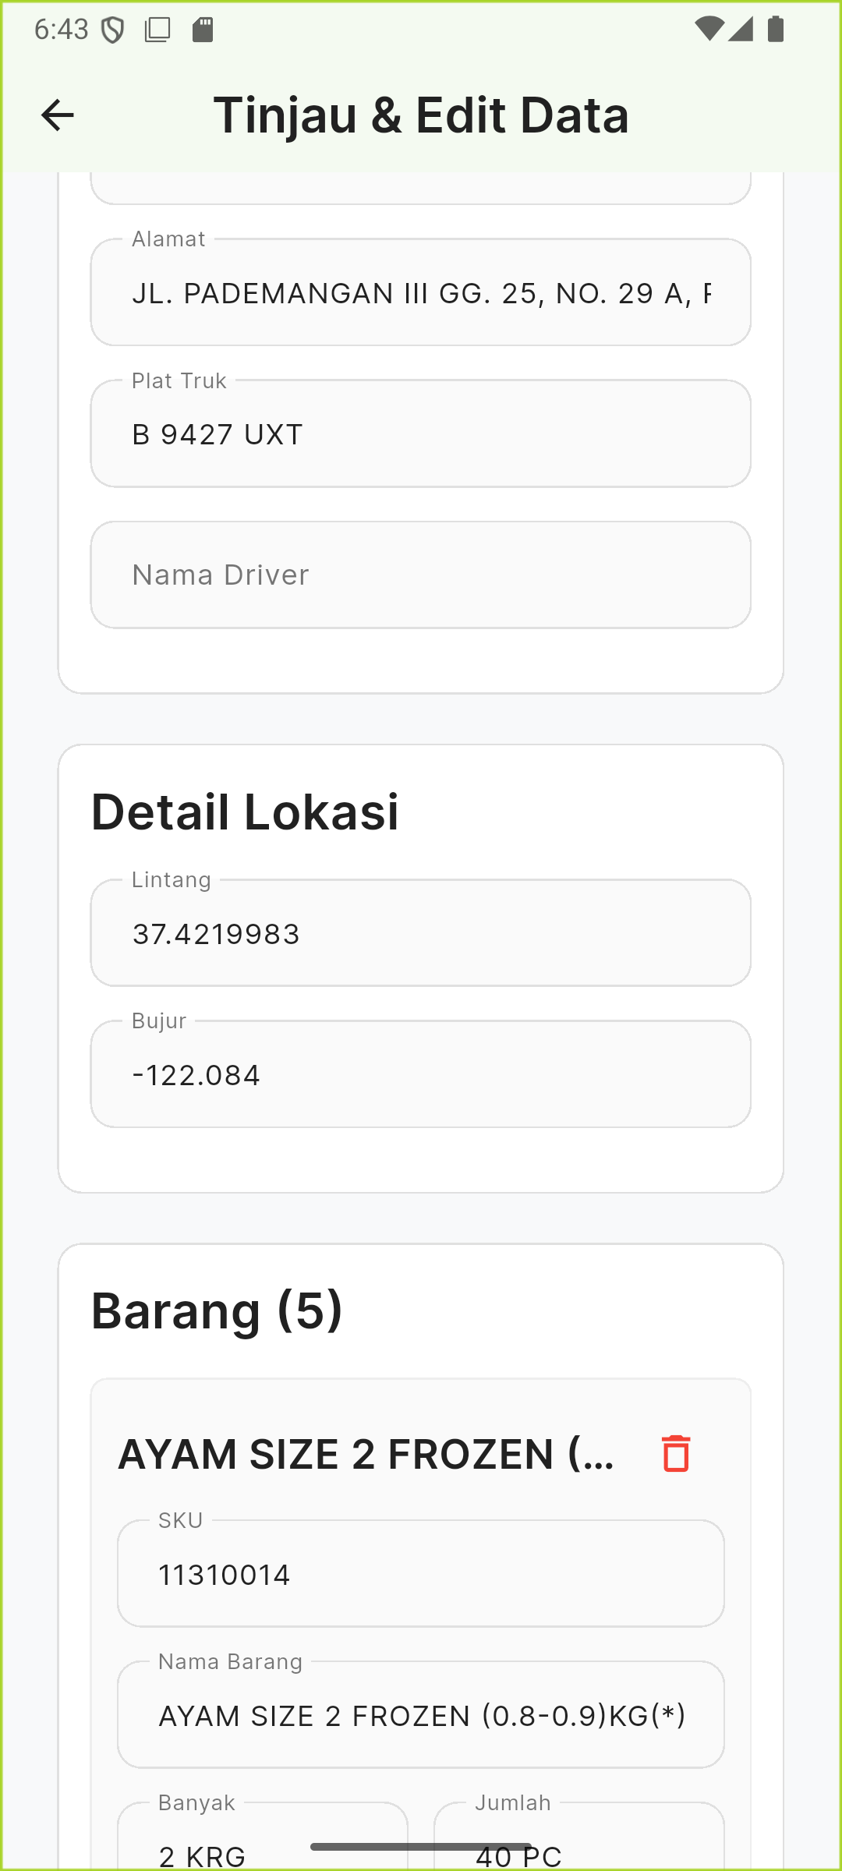
2
SECTION 2 • DO SCAN
Step 4 — Review & Edit: Real Extracted Data
▸ Real extraction: Tanggal, No PO/SO/DO, Kepada Yth, Order Untuk, Alamat, Plat Truk — all read directly off the photo.
▸ SKU matching: e.g. “Griller Size 2” on the paper → matched to 11310014 — AYAM SIZE 2 FROZEN (0.8-0.9)KG(*) in the master table.
▸ Fully editable: every field is a text box — the operator corrects mistakes before confirming.
Header fields — all OCR-read
5 items, matched to SKU master
Prima Mart Scanner — App Walkthrough
12

Slide 13
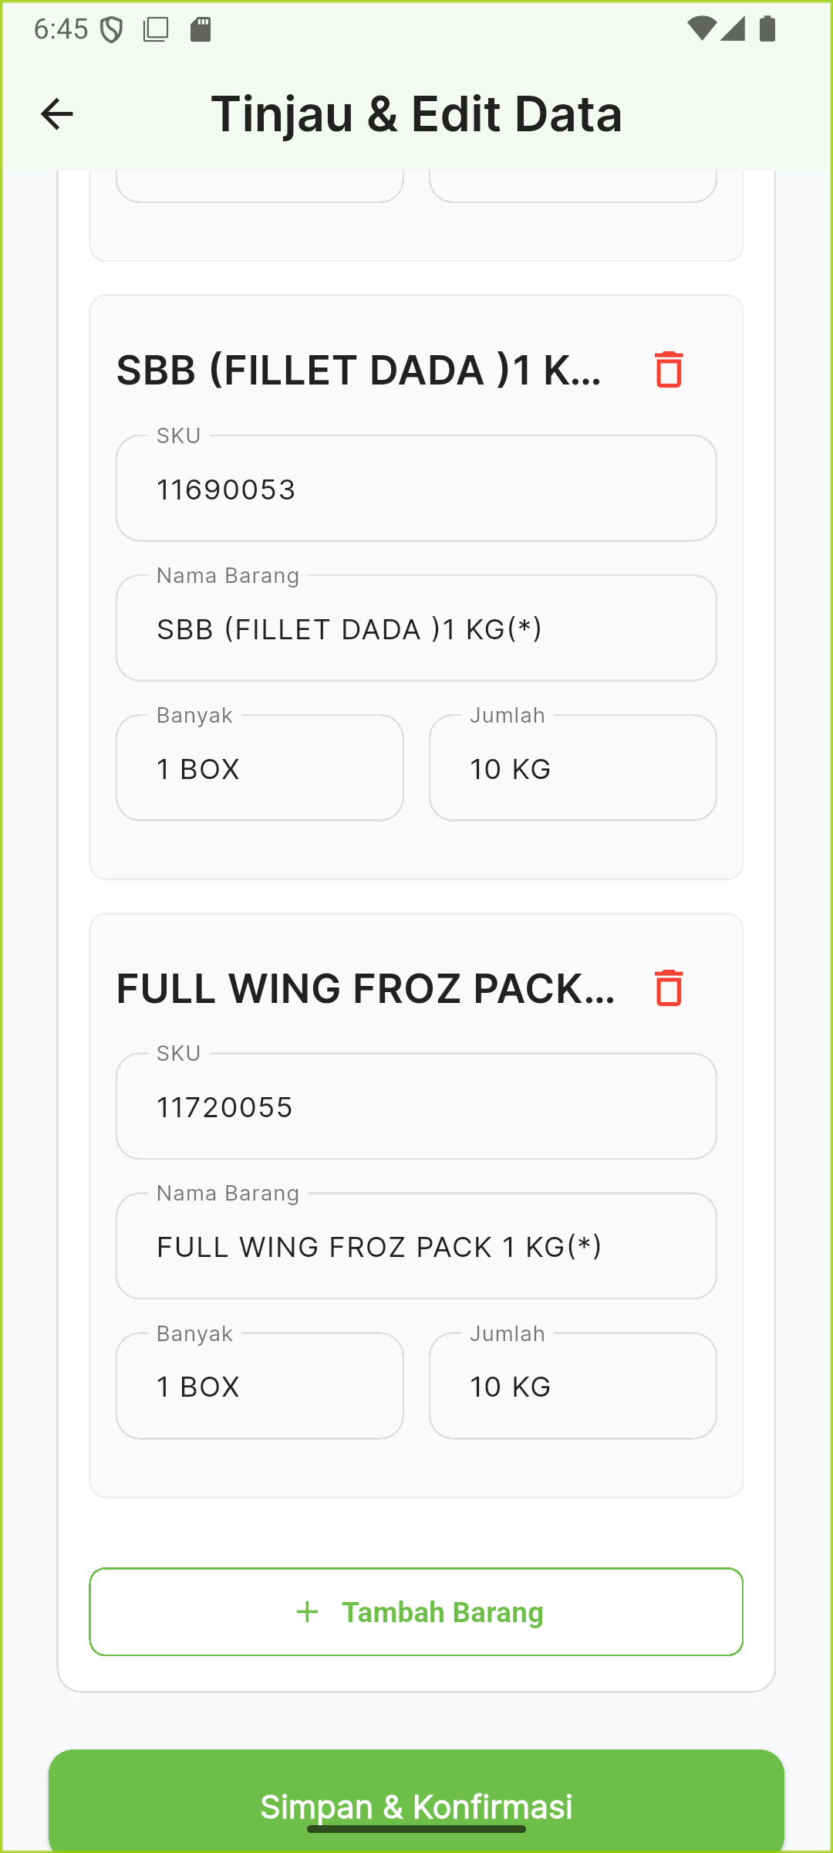
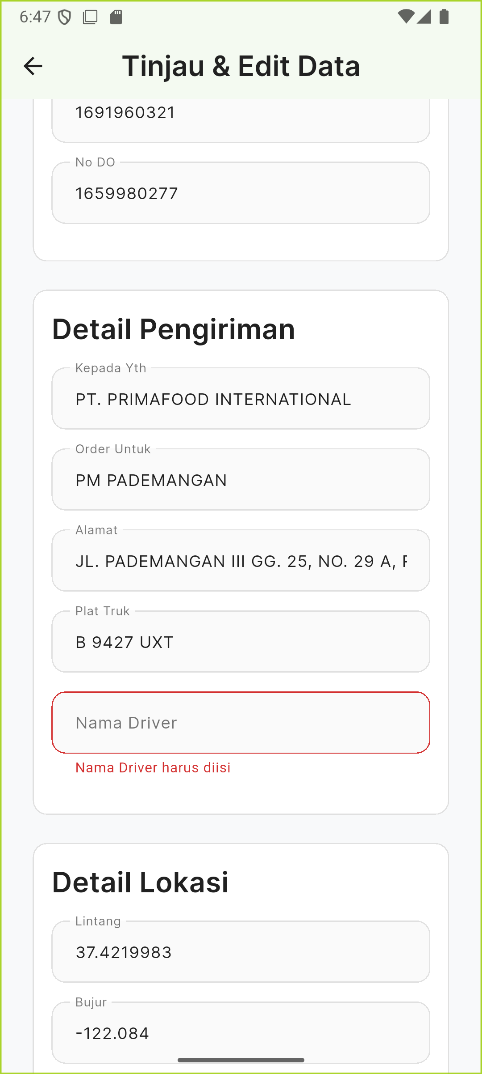
2
SECTION 2 • DO SCAN
Real Finding — Silent Validation on Submit
⚠ UX GAP FOUND LIVE
▸ “Nama Driver” was blank — photo only shows a signature, no printed name.
▸ Form.validate() fails and the button's onPressed just returns — no SnackBar, no scroll-to-error.
▸ Recommendation: surface a toast or auto-scroll to the first invalid field.
Tap Simpan & Konfirmasi — nothing visibly happens
The real reason, only visible on inspection
Prima Mart Scanner — App Walkthrough
13

Slide 14
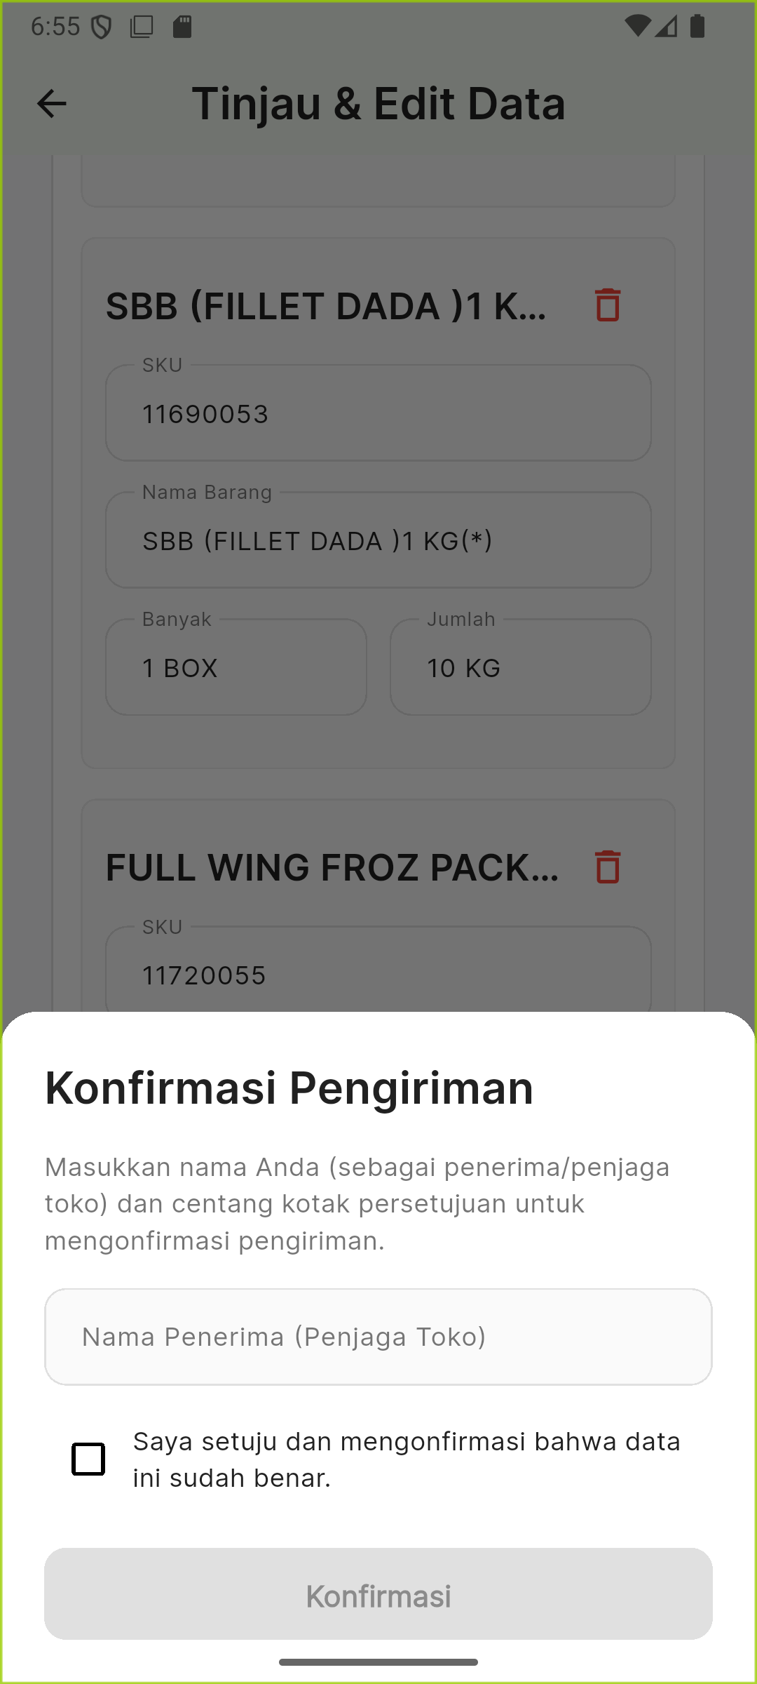
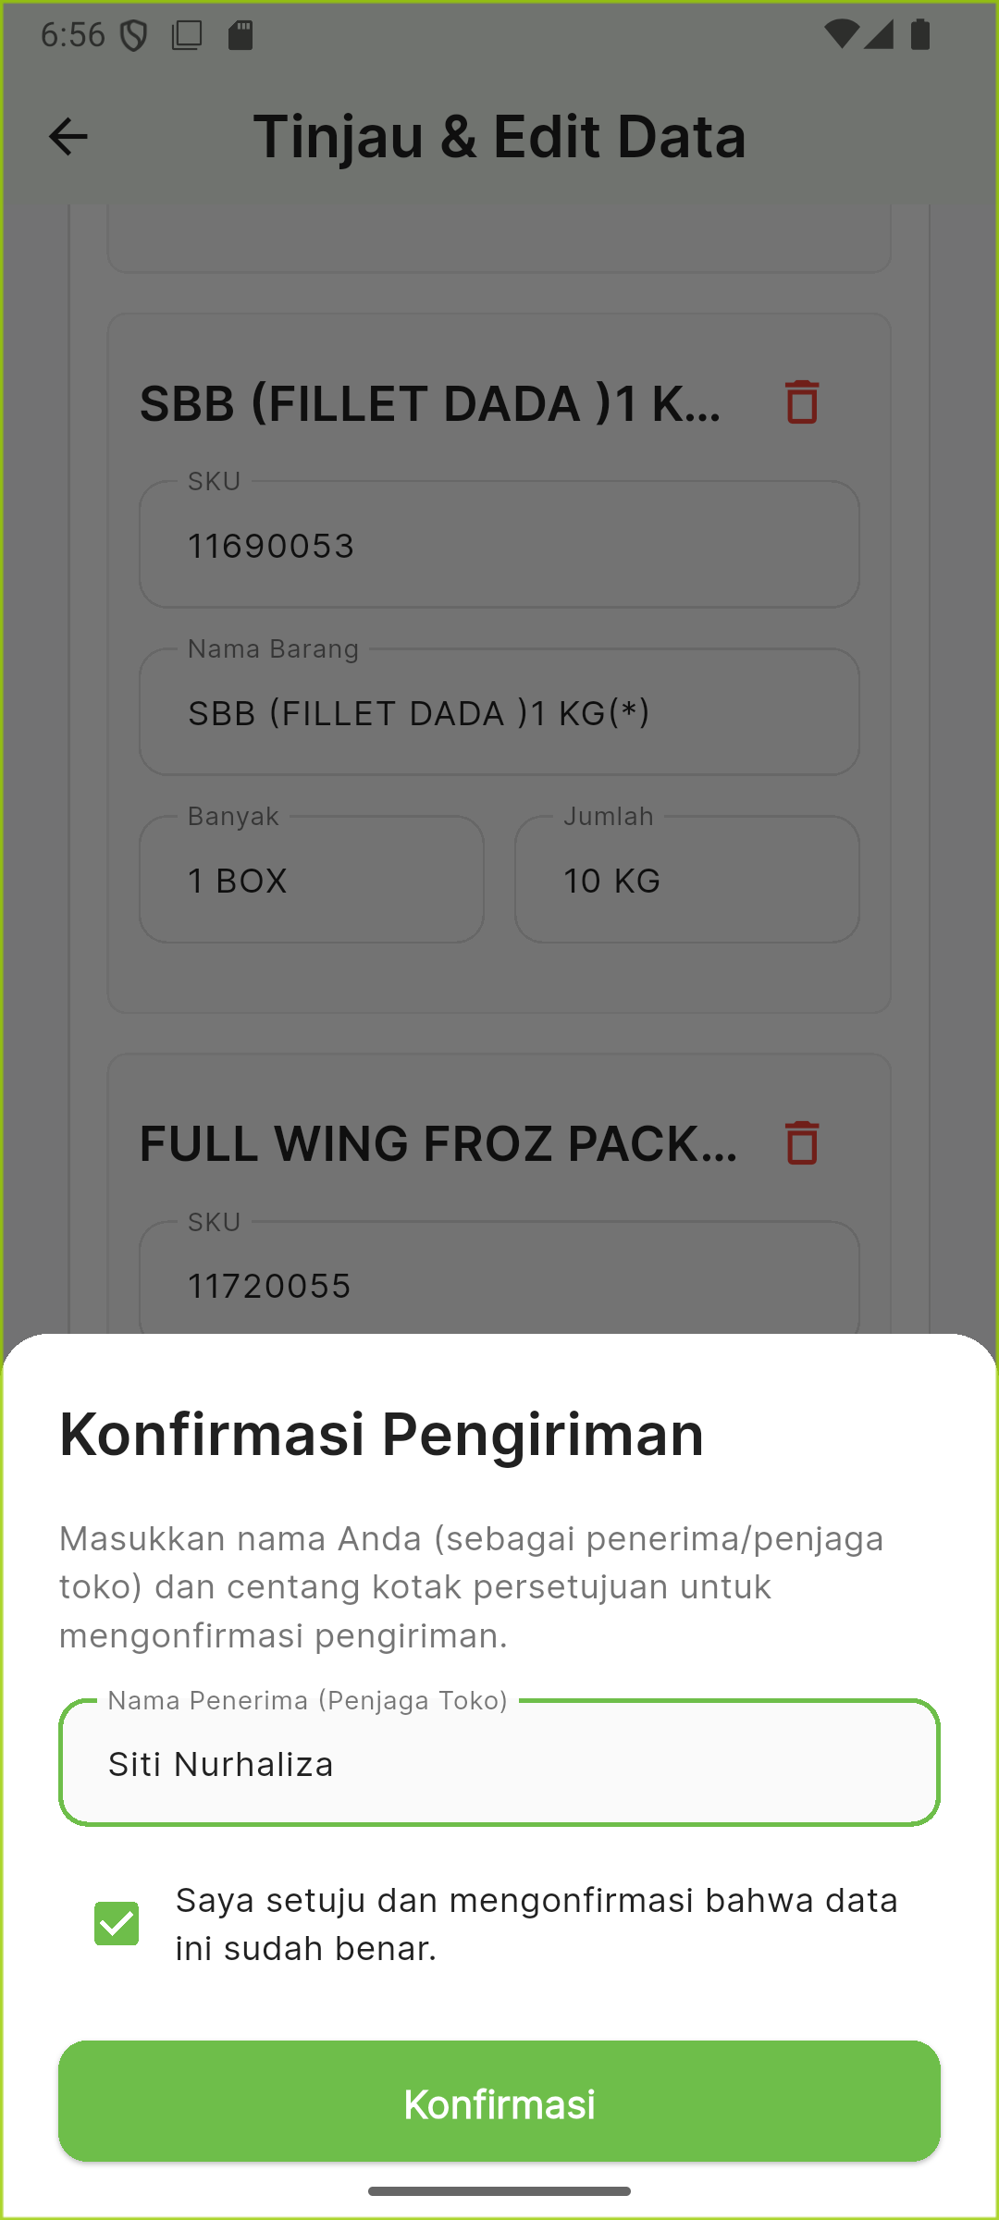
2
SECTION 2 • DO SCAN
Step 5 — Confirmation Gate (Newest Feature)
▸ Why it exists: so a delivery can't be silently marked confirmed without someone at the store actually acknowledging it.
▸ Nama Penerima — receiver / store-keeper name, required.
▸ Consent checkbox — “Saya setuju...” must be checked.
▸ Konfirmasi button stays disabled/greyed until both conditions are met.
▸ Shipped in the latest commit: “scan-mode sync, confirmation-gated documents.”
Konfirmasi Pengiriman dialog
Name + checkbox → button unlocks
Prima Mart Scanner — App Walkthrough
14

Slide 15
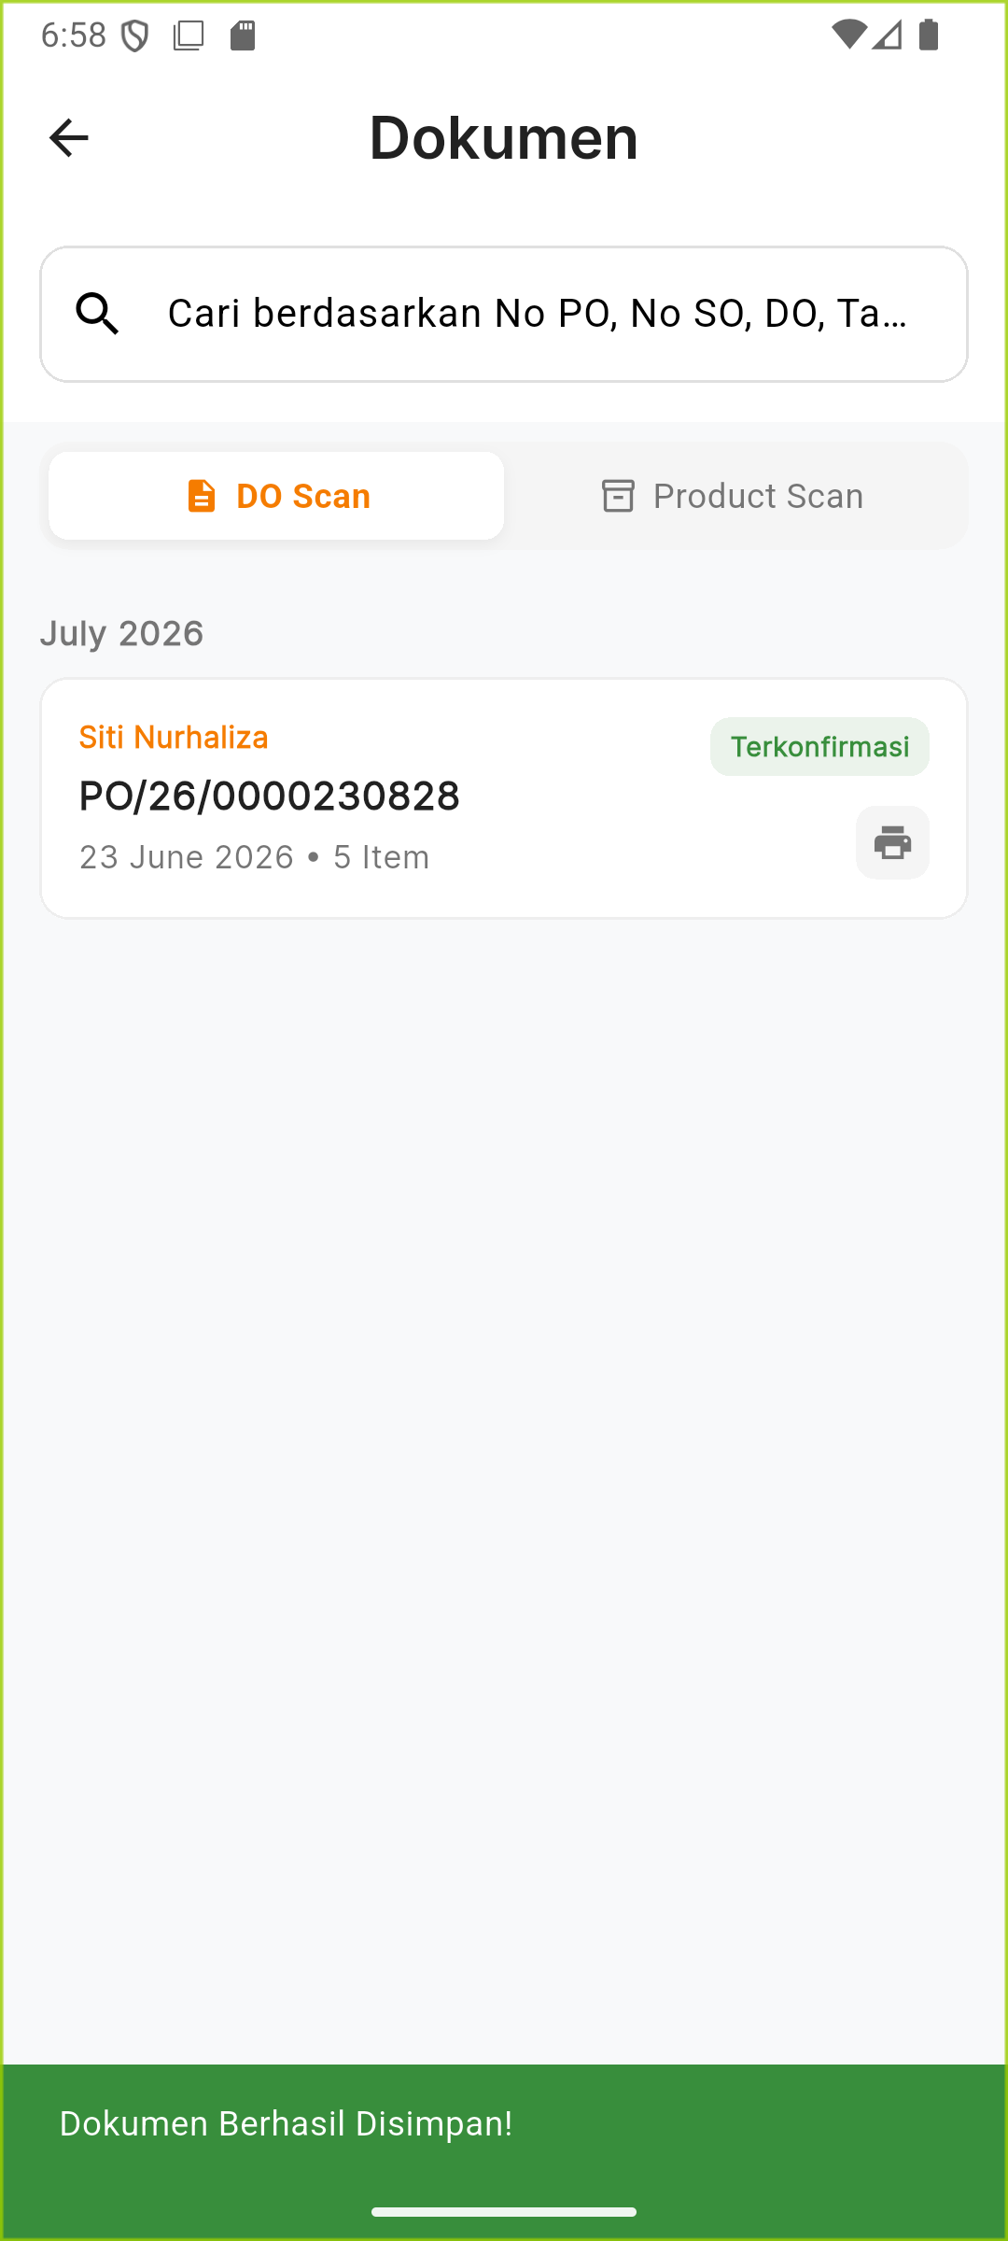
2
SECTION 2 • DO SCAN
Step 6 — Saved & Visible in History
▸ PUT-confirmed document now shows: receiver name, PO number, date, item count.
▸ Terkonfirmasi badge — green, matches the app's confirmed-state color.
▸ Card is tappable to re-open, and has a print icon top-right.
“Dokumen Berhasil Disimpan!”
History → DO Scan tab
Prima Mart Scanner — App Walkthrough
15

Slide 16
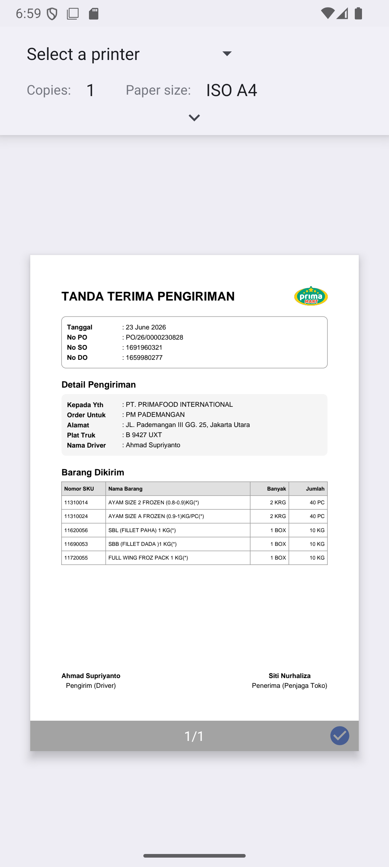
2
SECTION 2 • DO SCAN
Step 7 — Printable Delivery Receipt
“TANDA TERIMA PENGIRIMAN”
(delivery receipt), generated on-device from the same confirmed data.
▸ Header + full item table
▸ Driver signature line (Ahmad Supriyanto)
▸ Store receiver signature line (Siti Nurhaliza)
▸ Opens the real OS print dialog — ready to print or save as PDF
Real Android print dialog + generated PDF
Prima Mart Scanner — App Walkthrough
16

Slide 17
SECTION 3
Product Scan — End to End
Photo → AI SKU Classification → Auto Expiry Read → Confirm

Slide 18
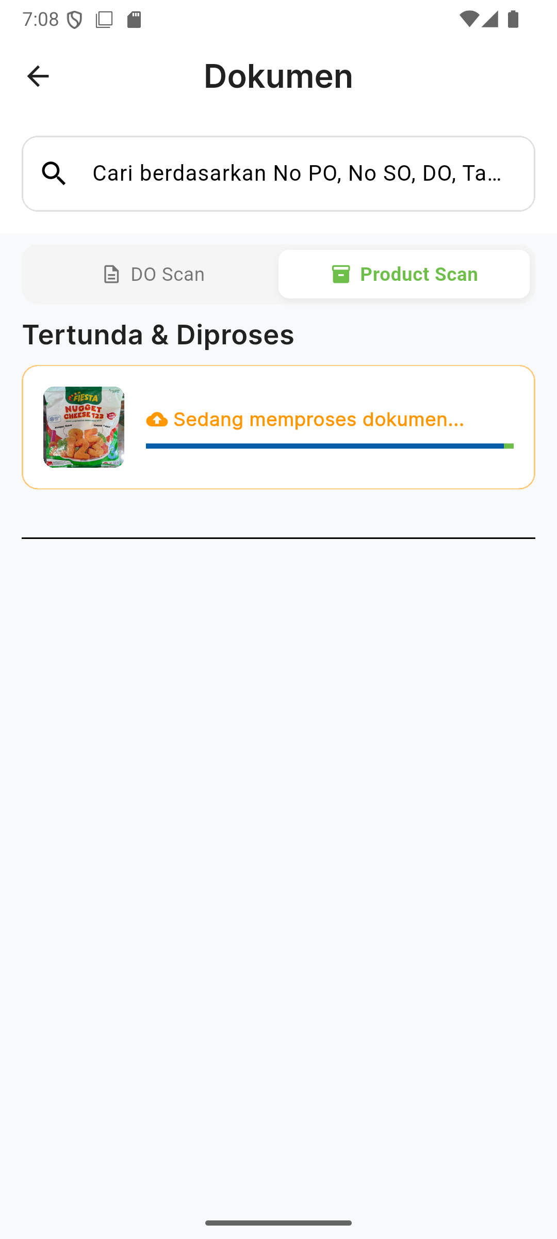
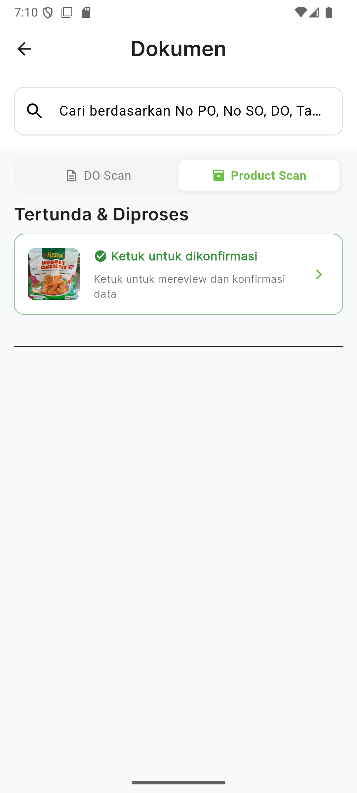
3
SECTION 3 • PRODUCT SCAN
Step 1–2 — Upload & Classify
▸ Same pending-queue mechanics as DO Scan — shared code path, different scan_mode tag.
▸ Backend runs DINOv2 similarity search + PaddleOCR expiry extraction in a single pass at upload time.
Uploading, Product Scan tab
Classified — ready to review
Prima Mart Scanner — App Walkthrough
18

Slide 19
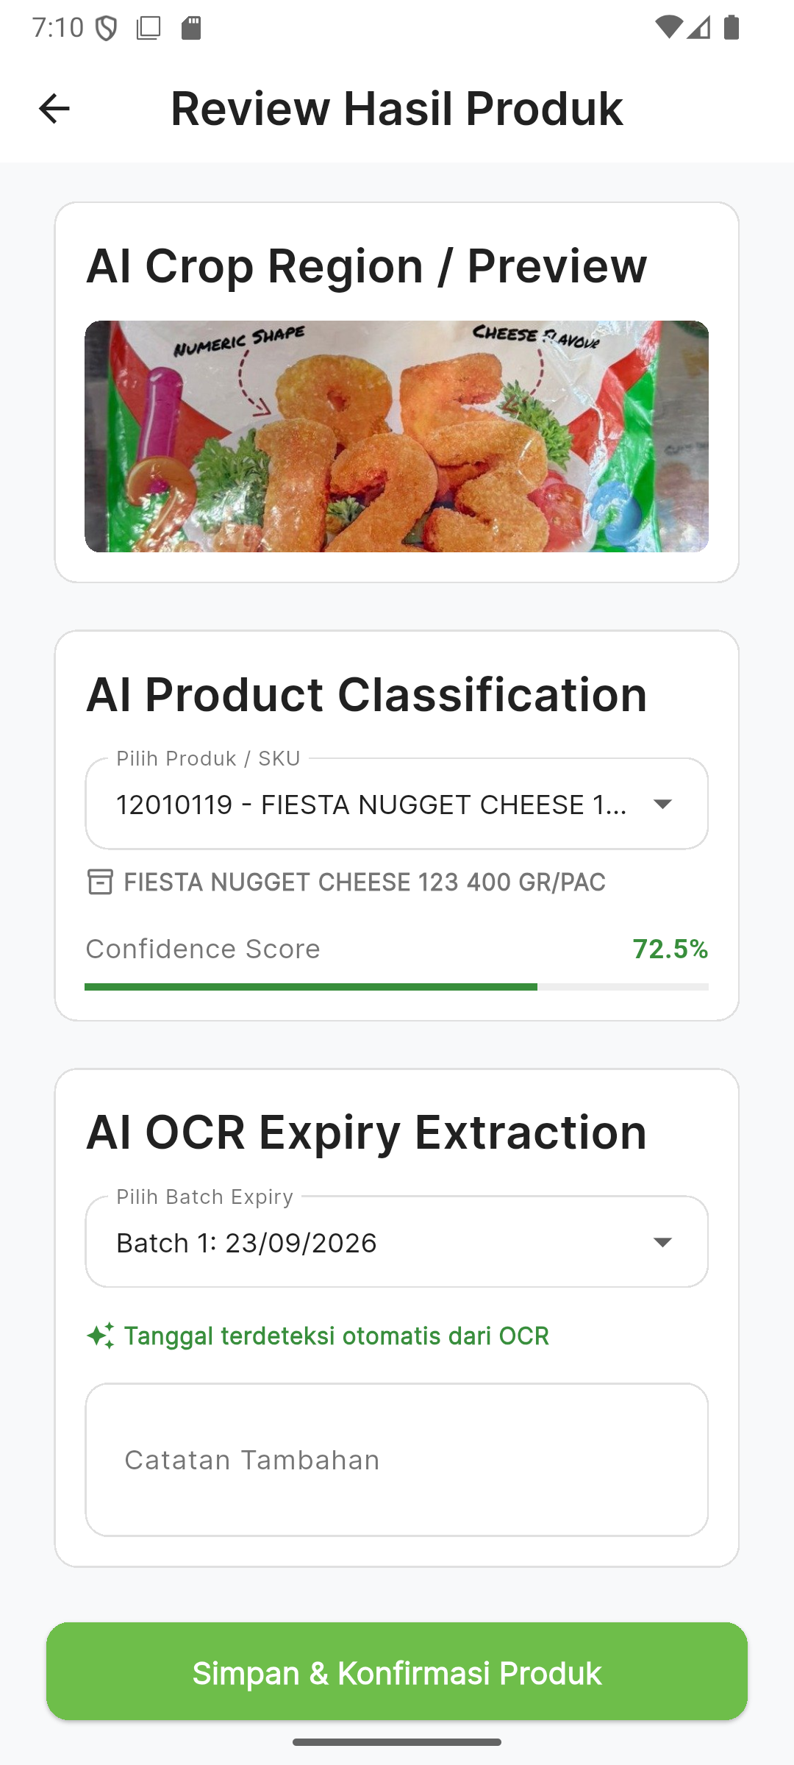
3
SECTION 3 • PRODUCT SCAN
Step 3 — Real AI Classification Result
▸ AI Product Classification: 12010119 — FIESTA NUGGET CHEESE 123 400 GR/PAC at 72.5% confidence — the exact SKU of the real photo used.
▸ How it works: a DINOv2 vision transformer embeds the photo (384-dim) and cosine-matches it against 118 reference photos across 16 known SKUs; score = best match within each class.
▸ Fallback: if DINOv2 is unavailable, a fine-tuned YOLO classifier (83.3% top-1 val accuracy) steps in — its scores are real softmax probabilities.
▸ AI OCR Expiry Extraction: Batch 1: 23/09/2026, tagged “Tanggal terdeteksi otomatis dari OCR” — read directly off the printed date, not guessed.
▸ No fake results: if classification is unreachable, the app shows an explicit retry screen instead of fabricating a match.
Review Hasil Produk
Prima Mart Scanner — App Walkthrough
19

Slide 20
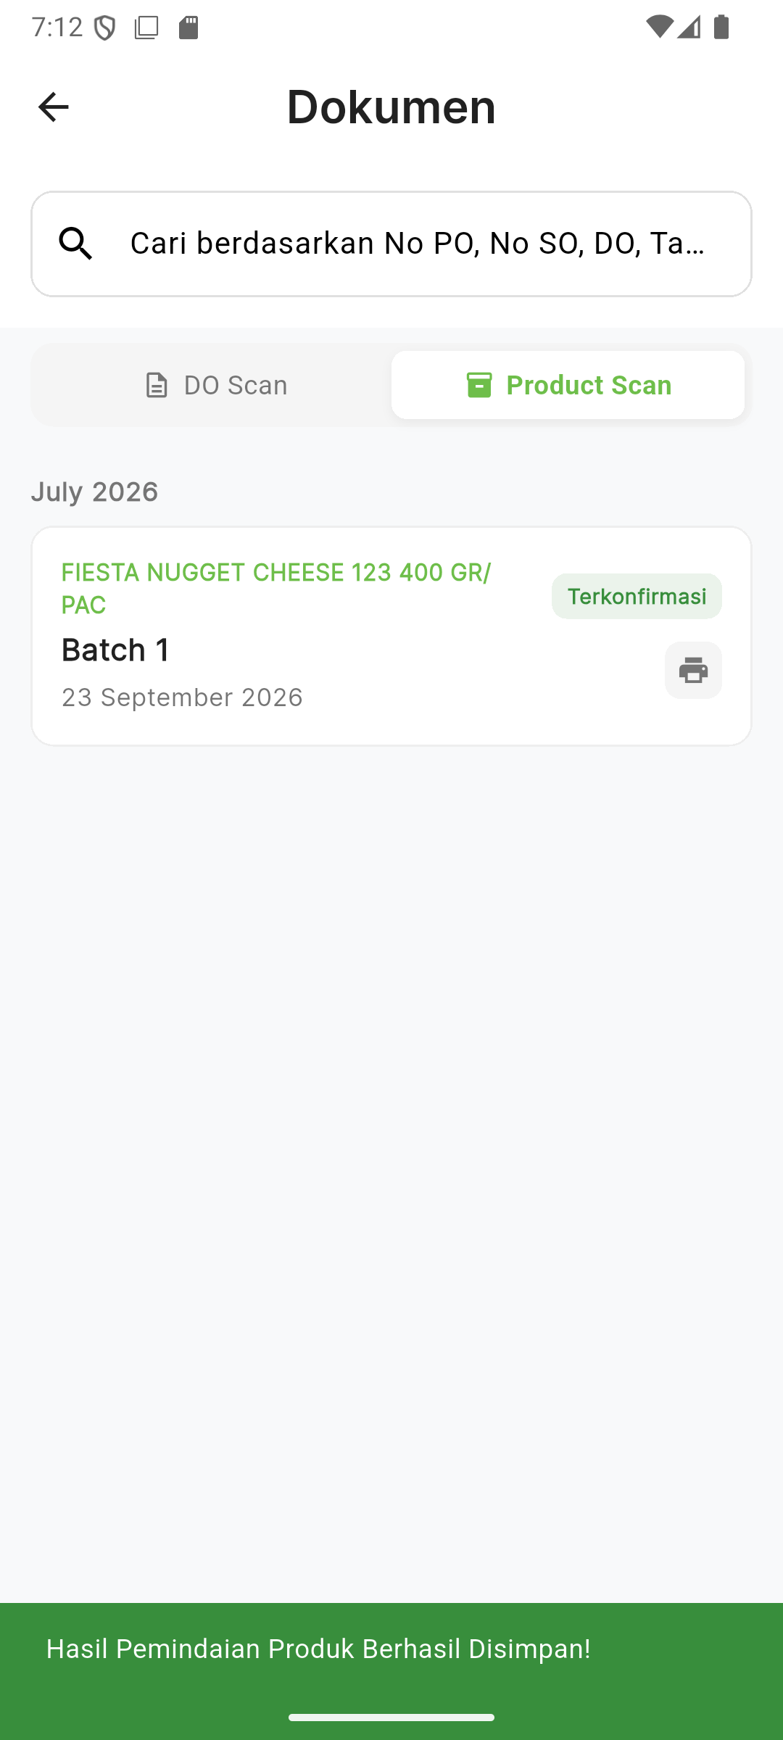
3
SECTION 3 • PRODUCT SCAN
Step 4 — Saved & Visible in History
▸ Card shows the confirmed SKU name, Batch 1, and expiry date.
▸ Same Terkonfirmasi badge convention as DO Scan.
“Hasil Pemindaian Produk Berhasil Disimpan!”
History → Product Scan tab
Prima Mart Scanner — App Walkthrough
20

Slide 21
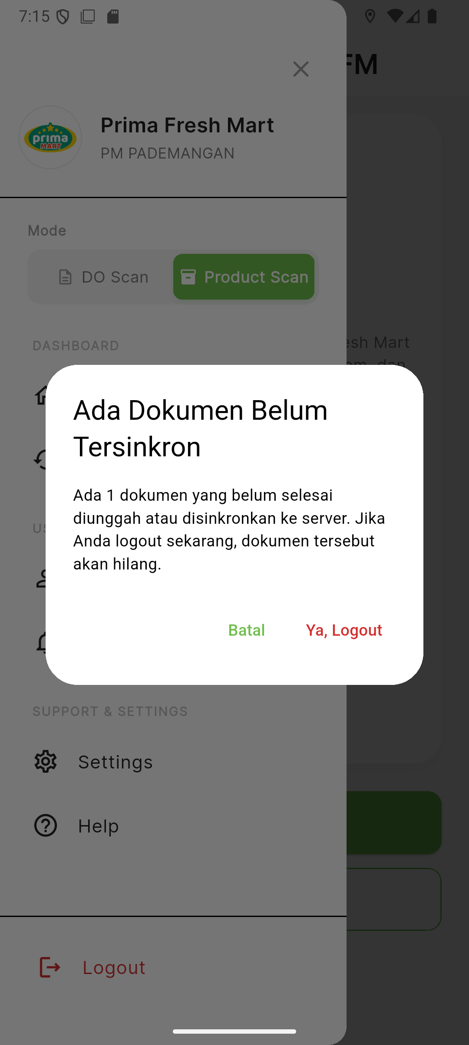
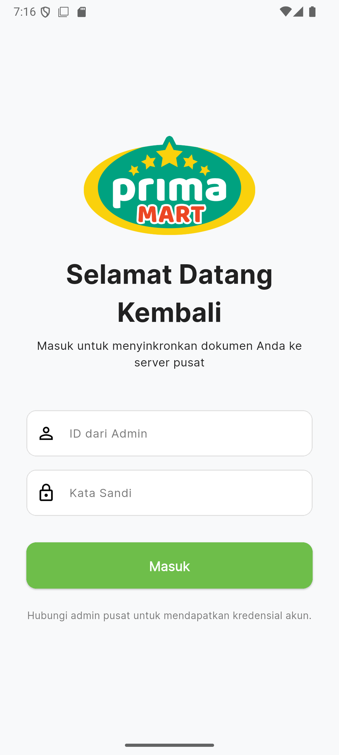
4
SECTION 4 • GUARDRAILS
Logout — Real Unsynced-Document Warning
▸ Data-driven warning: the “Ada 1 dokumen…” count comes straight from the live pending-queue length, not a canned string.
▸ If the queue is empty, Logout proceeds immediately — no dialog.
▸ Batal / Ya, Logout: cancel and stay, or confirm and clear the JWT + local Hive cache.
▸ Why it matters: a plain logout wipes the local cache — this stops an in-flight upload from silently vanishing.
“Ada Dokumen Belum Tersinkron”
Confirmed → back to login
Prima Mart Scanner — App Walkthrough
21

Slide 22
SECTION 4 • GUARDRAILS
What This Walkthrough Proves
100% Real Backend
Survives Real Failure
Every OCR field, classification score, and PDF value traces back to a real POST/GET — nothing hand-edited.
The network genuinely dropped mid-capture — the timeout screen shown is that real event, not a simulation.
Offline-Safe Queue
Human-in-the-Loop
Every capture lands in a local store before the network call starts — an app kill mid-upload loses nothing.
Confirmation gate + unsynced-logout warning both exist specifically to stop silent, unacknowledged data loss.
Prima Mart Scanner — App Walkthrough
22

Slide 23
Thank You
Full detail in WORKFLOW.md — 32 real-backend screenshots in screenshots/v2/
Prima Mart Scanner — PT. Primafood International

